Slide 1


Smart
Data
Donation
Service
Smart Data
Donation Service

Slide 2
Data Asymmetry
Data Incongruity
Data Dependence

Slide 3
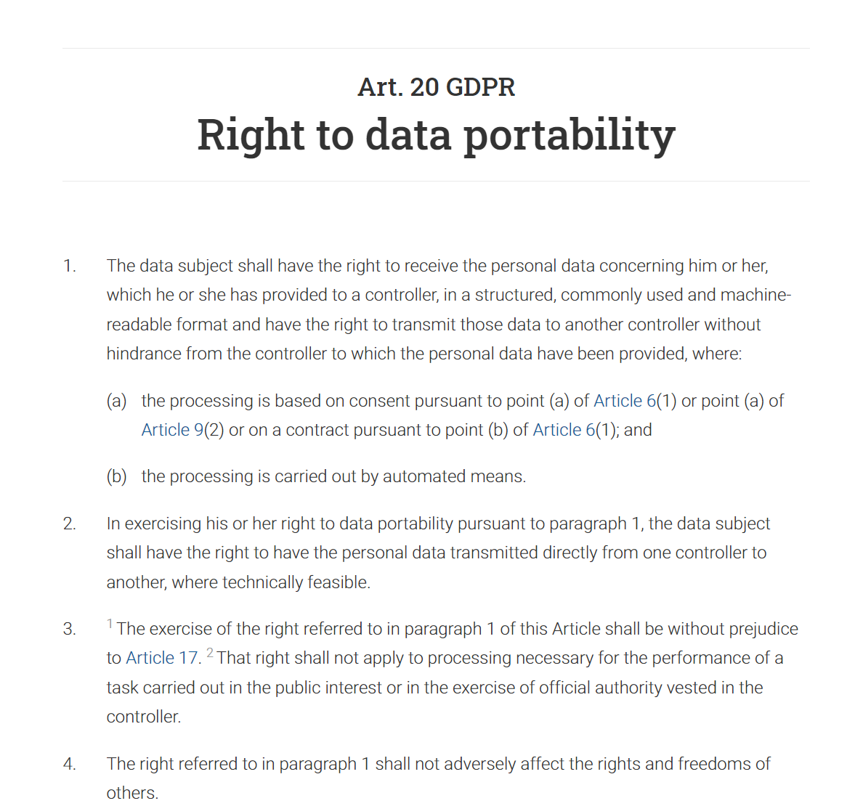
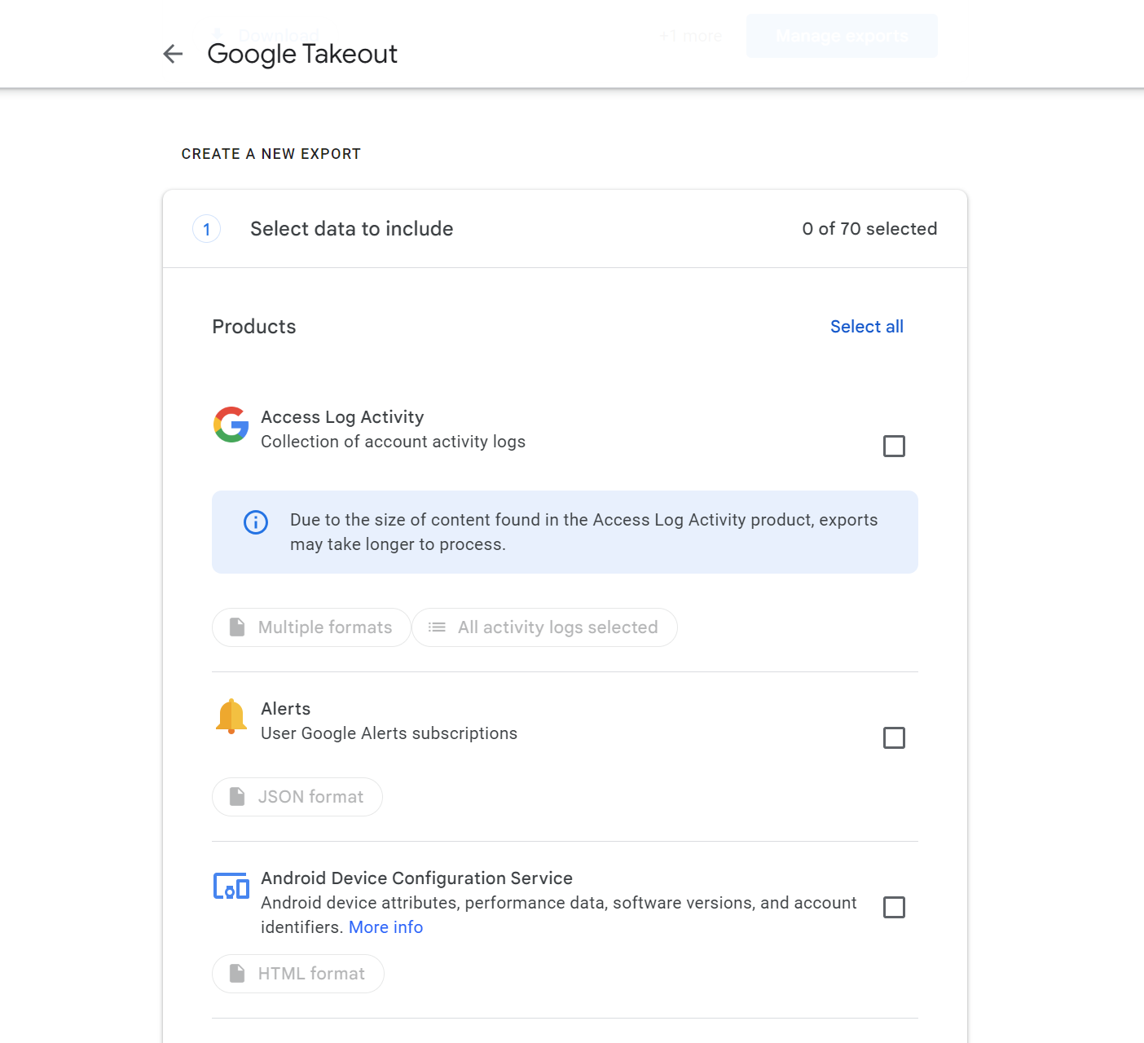

Slide 4
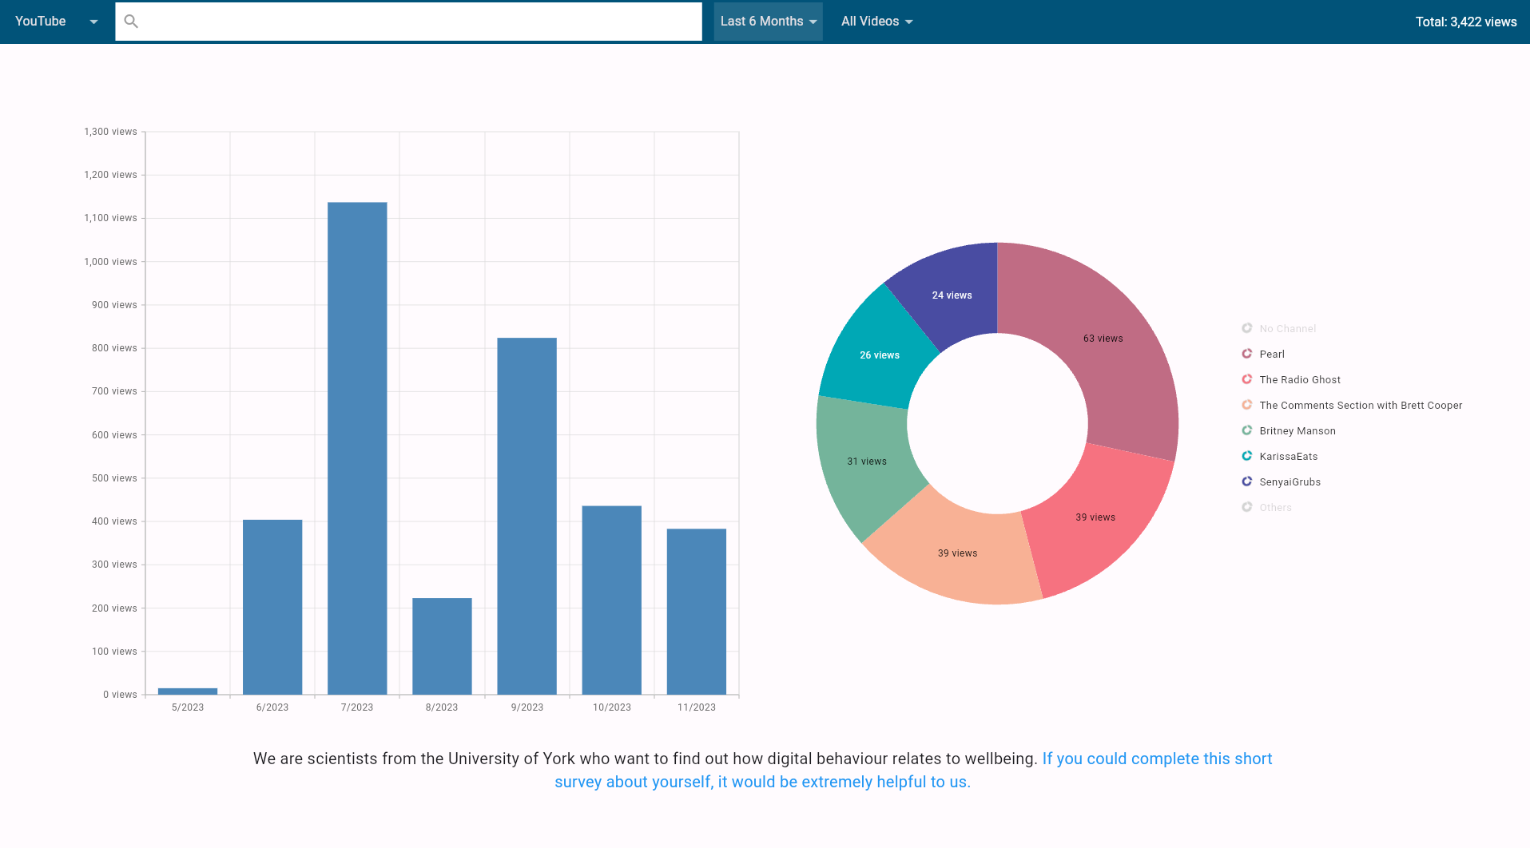
Notes:
Databank of over 5,500 individuals

Slide 5
Granular
Longitudinal
Retrospective
Identifiable

Slide 6


Slide 7
Data Acquisition
Data Security
Data Access

Slide 8
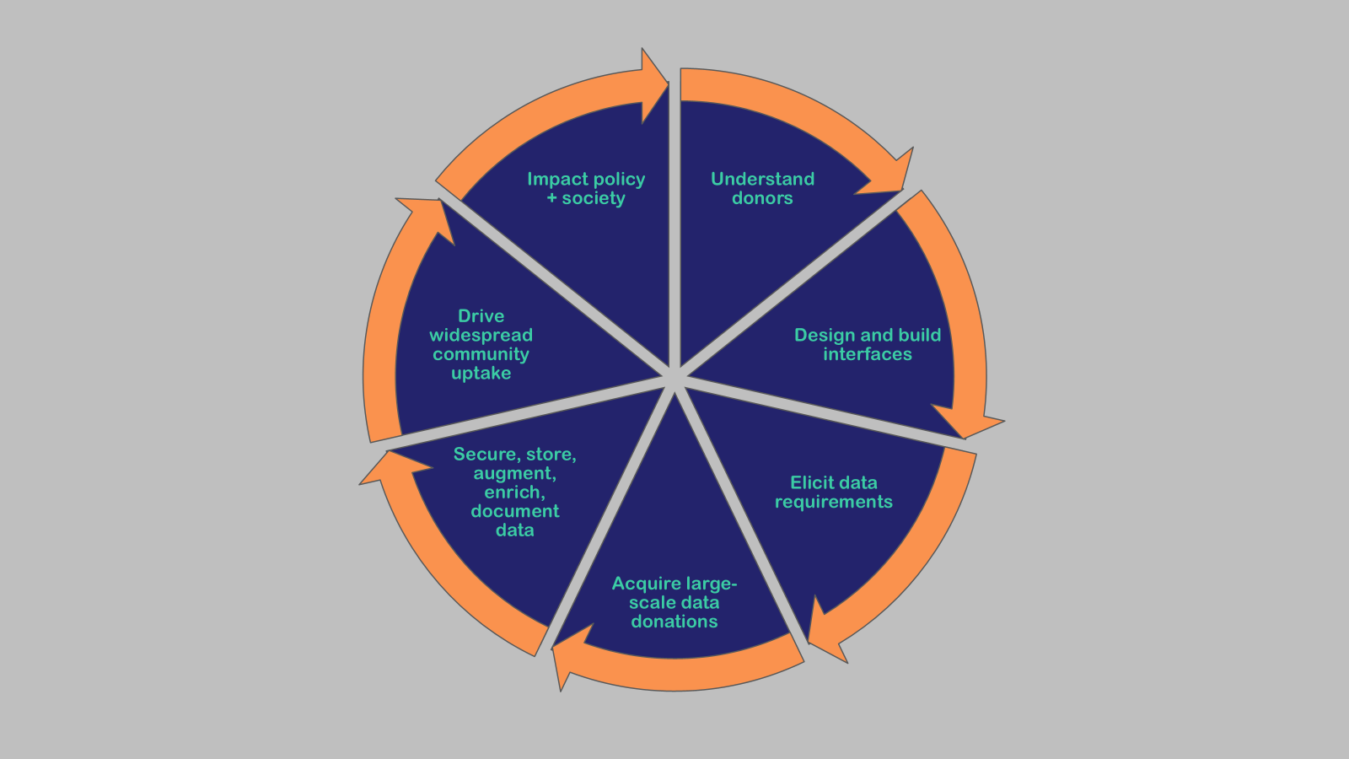

Slide 9




Smart
Data
Donation
Service
SDDS: Key Interventions
Smart Data
Donation Service
Help citizens exercise their data rights
Enable transparent & secure data donations
Create measurable benefit for donors
Ground-breaking data for research
ACCESS RIGHTS
DONATE DATA
SDDS
SAFE ACCESS
PERSONAL DATA
BENEFITS
INSIGHTS
Corporations
Citizens
Research

